Slide 1
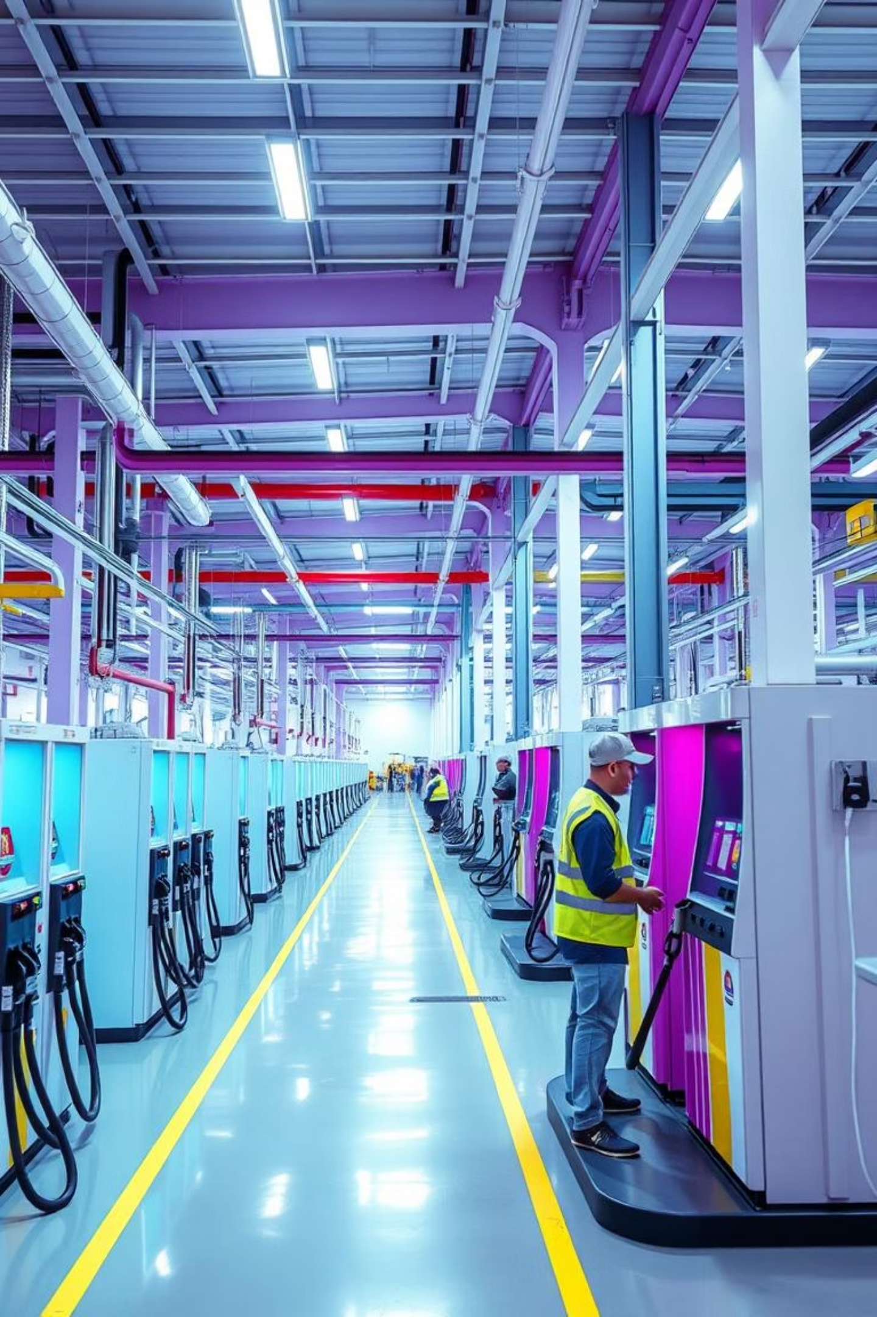
Machine Downtime
By
C.R.Sravana Rekha
14/02/2025

Slide 2
Contents
1
Business Objective
2
Business Constraints
3
Project Architecture - Data Flow Diagram
4
Data Collection
5
Exploratory Data Analysis
6
Data Visualization

Slide 3

Business Problem
Problem Statement
Objective
Unplanned machine downtime in fuel pump manufacturing is causing productivity loss.
Minimize unplanned downtime while controlling maintenance costs.
Success Criteria
Business: Reduce downtime by at least 10%.
Economic: Achieve cost savings of at least $1M.

Slide 4
Project Overview and Scope
Project Overview
Project Scope
This project analyzes machine downtime data (sensor readings and event logs) from November 2021 to June 2022 to identify actionable insights for predictive maintenance. By analyzing key metrics, we aim to understand the drivers of downtime and develop strategies to minimize its occurrence.
Leveraging SQL, Python, and Power BI, this project explores downtime rates, machine metric trends, correlations between metrics and downtime, and downtime distribution patterns. The results will inform maintenance strategies and resource allocation.

Slide 5
Data Dictionary
Name of the feature
Data type
Description
Usage in Analysis
1.
Date
Date
Date when the machine parameters were recorded.
Time-series analysis for identifying trends and failure patterns.
2.
Machine_ID
Categorical
Unique identifier for each machine unit.
Grouping and filtering for machine-specific analysis.
3.
Assembly_Line_No
Categorical
Indicates the shop floor or line where the machine is located.
Useful for line-specific performance analysis.
4.
Hydraulic_Pressure(bar)
Continuous
Hydraulic pressure measured in bars.
Detecting anomalies and correlations with machine failure.
5.
Coolant_Pressure(bar)
Continuous
Pressure of the coolant in bars.
Analyzing machine cooling efficiency.
6.
Air_System_Pressure(bar)
Continuous
Air pressure in the machine's system.
Relationship with operational efficiency.
7.
Coolant_Temperature
Continuous
Coolant temperature in degrees Celsius.
Monitoring overheating risks.
8.
Hydraulic_Oil_Temperature(°C)
Continuous
Temperature of the hydraulic oil.
Evaluating system stability and health.
9.
Spindle_Bearing_Temperature(°C)
Continuous
Spindle bearing temperature in degrees Celsius.
Indicator of bearing wear or heat buildup.
10.
Spindle_Vibration(µm)
Continuous
Vibration level of the spindle measured in micrometers.
Key metric for mechanical health monitoring.
11,
Tool_Vibration(µm)
Continuous
Tool vibration level measured in micrometers.
Correlated with tool wear and efficiency.
12.
Spindle_Speed(RPM)
Continuous
Spindle speed in revolutions per minute (RPM).
Analyzing operating efficiency and machine performance.
13.
Voltage(volts)
Continuous
Voltage supplied to the machine.
Indicator of power stability.
14.
Torque(Nm)
Continuous
Torque applied by the spindle.
Related to load and operational efficiency.
15.
Cutting Forces(kN)
Continuous
Force applied during the cutting process.
Measure of cutting intensity and wear factors.
16.
Downtime
Categorical
Indicates if the machine experienced downtime or failure (Machine_Failure or No_Machine_Failure).
Target variable for predictive failure models.

Slide 6
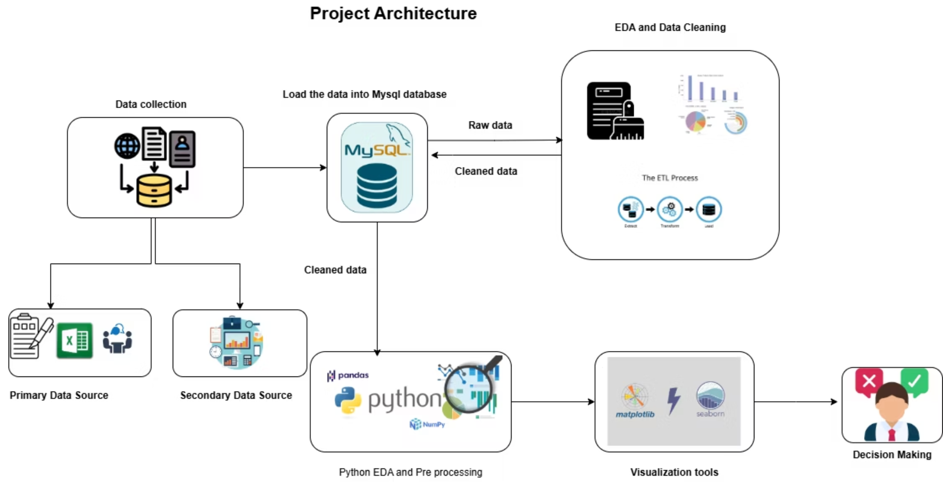
Project Architecture

Slide 7
Exploratory Data Analysis: Statistical Insights
1
Assembly Line No. Shopfloor - L1 experiences the highest rate of machine failures.
2
Machine failures in 2022 were higher compared to 2021.
3
Voltage shows high kurtosis, pointing to possible outliers or extreme values.
4
Downtime is most frequently categorized as "Machine Failure," signifying more failures than non-failures.
5
Hydraulic Pressure has a noticeable skew, indicating an imbalanced distribution with a longer right tail.

Slide 8





Exploratory Data Analysis: Business Insights
Focus on L1
Focus on improving maintenance for Assembly Line No. Shopfloor - L1 to reduce failure rates.
Equipment Upgrade
The rise in machine failures in 2022 may be due to older machines; replacing or upgrading aging equipment is recommended.
Voltage Stability
Ensure Voltage stability by monitoring and preventing fluctuations that could lead to failures.
Condition Monitoring
Implement condition-based monitoring to assess machine health and trigger timely maintenance when necessary.
Pressure Sensors
Deploy pressure sensors for Hydraulic Pressure to provide real-time alerts when values exceed safe limits, preventing potential issues.

Slide 9
Data Preprocessing
Data Collection
1
Data for the analysis is collected from a secondary source in the form of a CSV file
2
Data Cleaning
Handling missing values. Corrected date format. Detected and treated outliers.
Data Transformation
3
Converted data types for consistency.
4
Statistical Analysis
Descriptive Statistics: Computed mean, median, mode, variance, skewness, and kurtosis. Analyzed data distribution and patterns.
Exploratory Data Analysis (EDA)
5
Visualized relationships and distributions. Identified key insights and trends. Created visualizations like histograms, boxplots, and correlation matrices.

Slide 10
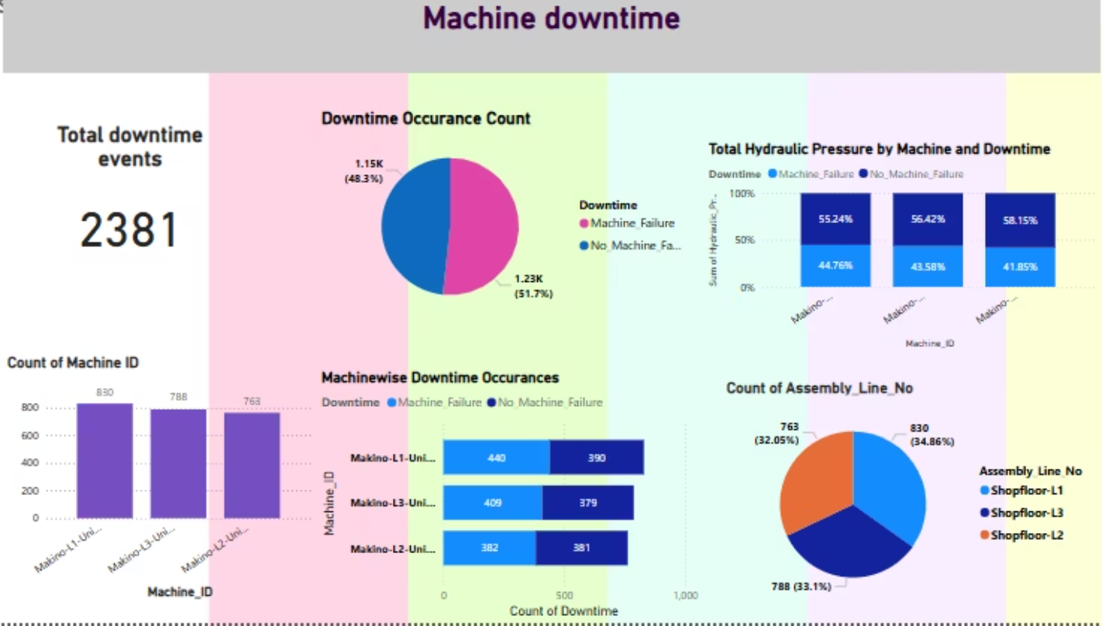
Data Visualization

Slide 11
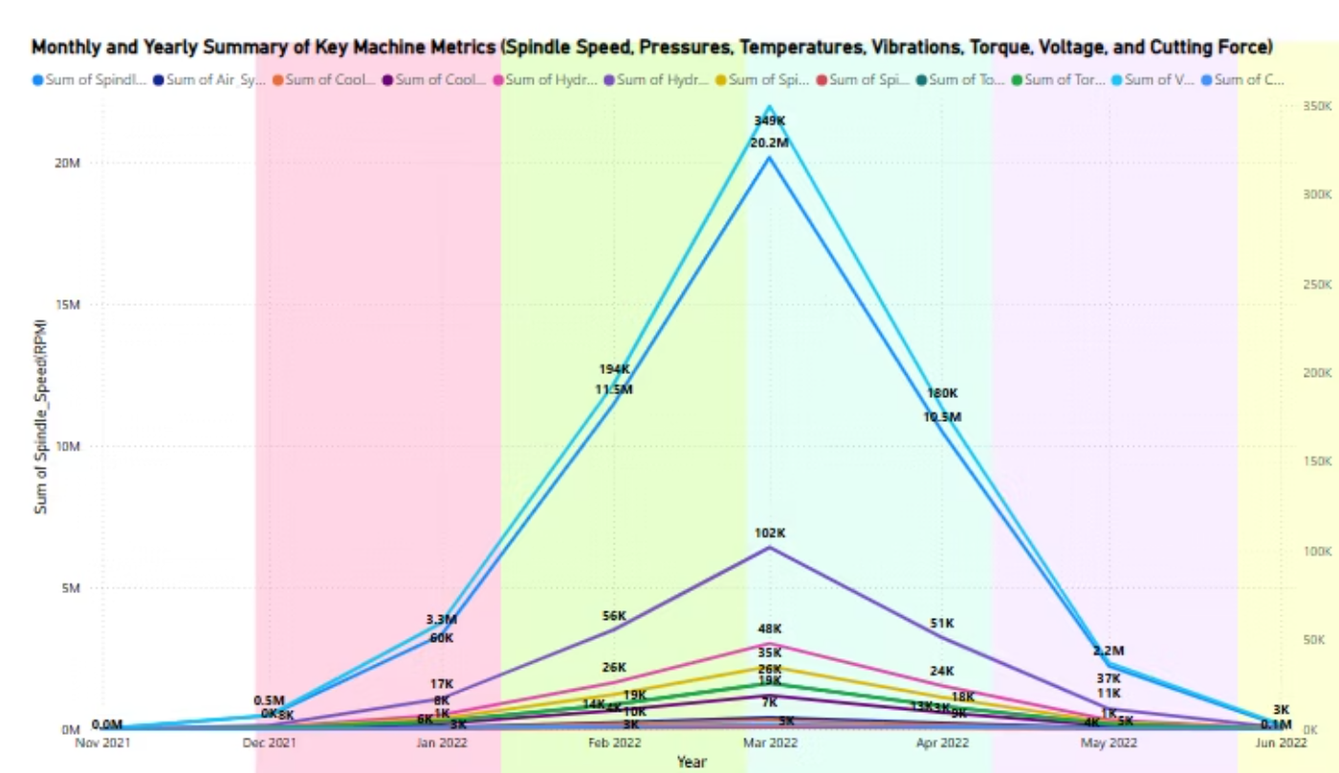

Slide 12


